Slide 1
Article Recommendation System
By Team 404

Slide 2
Building a simple, yet sophisticated Article Recommender System

Slide 3
The User

Slide 4
The User
Definite Taste
Taste not very volatile
Few actions per day
Can be categorised into different types
Analysing the user of the article recommender system.

Slide 5
Model Requirements
A model capable of grouping similar types of items on the basis of their content.
A model which can group people on the basis of their affinities.
A model which is steadfast
A model which works well with very few actions, however takes these actions into account before recommending a new set of items
Which model would best suite our user?

Slide 6
The Data
From CI&T's Internal Communication platform (DeskDrop).
Contains a real sample of 12 months logs (Mar. 2016 - Feb. 2017)
Contains about 73k logged users interactions on more than 3k public articles shared in the platform.
The training set contains the first (as per timestamp) 80% of the data.
The testing data contains the remaining 20%.

Slide 7
The Model

Slide 8
The Model
Different algorithms for new and old users.
New users - clustering and most popular
Regular users - Hybrid of interactive content based filtering and collaborative filtering with some inspiration from Reinforcement Learning.
A bird eye view of the model.

Slide 9
Ratings
Weights of parameters = (100 - n*8)% of assigned weights
Where n = number of months ago a particular action was taken
min(n) = 12
Time Strength = (100 - n*8)
Weights assigned to various parameters (action strength):
'VIEW': 1.0
'LIKE': 2.0
'BOOKMARK': 3
'FOLLOW': 3.0
'COMMENT CREATED (if liked)': 3.5
Event Strength = Action Strength * Time Strength

Slide 10
Regular Users
Actions > 5
Interactive content based filtering (A) - Items which are similar to user’s preferences
Collaborative Filtering (B) - Items which are preferred by users similar to our current user.
A ∩ B | A ∩ B | A ∩ B | A ∩ B | A ∩ B | A ∩ B | A - B | A - B | B - A | B - A
Hybrid Model
Ensures Individuality
Serendipity

Slide 11
Content based
Finding similarity using TF - IDF
TF - IDF reflects how important a word is an article of a given corpus.
TF(t) = (Number of times term t appears in a document) / (Total number of terms in the article)
IDF(t) = log_e(Total number of articles/ Number of articles with term t in it)
TF-IDF score = TF*IDF

Slide 12
Content based
 | Word 1 | Word 2 | Word n | Word 5000
Article 1 | 3 | 2 | 1 | 5
Article 2 | 5 | 3 | 2 | 1
Rating
3
4
Article n+1 | 2 | 3 | 2 | 4
5
User Profile
Word 1 | Word 2 | Word n | Word 5000
8 | 6 | 3 | 6
New User Profile
Word 1 | Word 2 | Word n | Word 5000
7 | 6 | 3 | 7

Slide 13

Content based
User profile is compared with the vector of every article and the most similar articles are found using Cosine Similarity.

Slide 14
Collaborative filtering
Matrix Factorization using SVD
The unknown ratings are found using the Gradient Descent Algorithm
𝝰 = 0.03
n = 10

Slide 15
New Users
10 clusters of articles formed using centroid based based K-means clustering
Most popular article displayed for each new user (with no actions)
For every action ( < 5) n * 2 content based recommendations, and (10 - 2*n ) recommendations on the basis of the above mentioned method.

Slide 16
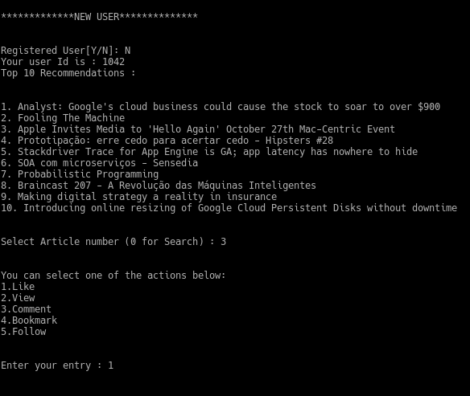
Suggestions
for
New User

Slide 17
Train-Test Split
Split by a reference date
The train set is composed by all interactions before that date - 31284
The test set are interactions after that date - 7822
Split ratio- 4:1

Slide 18
Accuracy
Recall@n methodology used
Percentage of the number of items actually viewed from n recommendations
52% - recall@10
40% - recall@5
Testing the accuracy of our model.

Slide 19
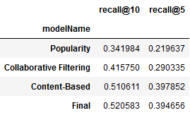
Accuracy
Testing the accuracy of our model.

Slide 20
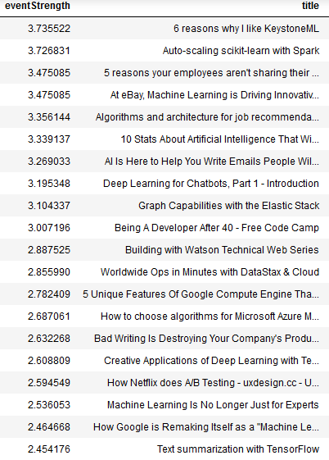
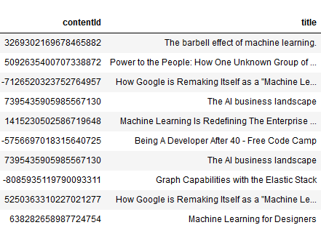
User #1
Recommendations generated

Slide 21
Conclusion
Model based on user behaviour
Dynamic recommendations on timestamp
Tackling the problem of ‘groupism’ born out of CF by actively preserving individual choice
Serendipity and Exploration an integral part
Problem of Cold Start effectively tackled
The highlights of the model

Slide 22
Thank You!
Questions?

